Slide 1
Using the formula for the area of a triangle
Perimeter and area

Slide 2
how to use Oak lessons

Slide 3
I can use the formula for the area of a triangle to calculate missing side lengths.

Slide 4
The base is the side which is perpendicular to the height.
The perpendicular height is the perpendicular distance from the base to the opposite vertex.

Slide 5

Using the formula for the area of a triangle
Calculating the area of a triangle
Calculating a side length

Slide 6
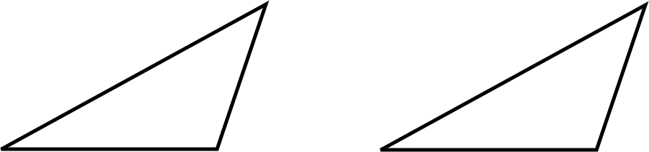
Calculating the area of a triangle
To calculate the area of a triangle, the base and height are used.
The base and height of the triangle must be perpendicular to each other.
base
height
height
base

Slide 7
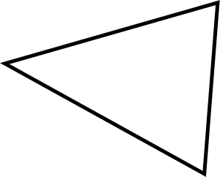

Calculating the area of a triangle
The base and height of this triangle measure:
10 mm and 12 mm
16 mm
12 mm
12 mm and 15 mm
15 mm
10 mm
10 mm and 15 mm
10 mm and 16 mm

Slide 8
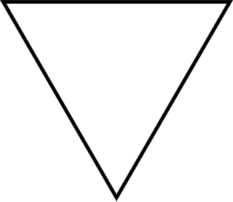
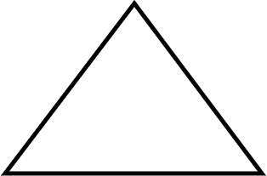



Calculating the area of a triangle
3 km
6 m
6 m
5 km
6 km
5 m
7 m
Area =
=
=
Area =
=
=
m²
km²

Slide 9
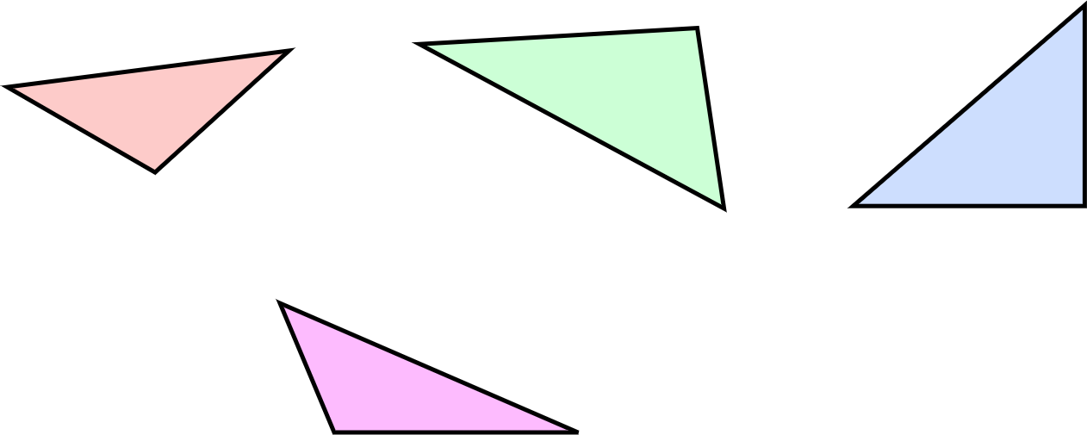
Calculating the area of a triangle
1) Calculate the area of each triangle.
a) b) c)
4 cm
5 cm
2 cm
5 cm
3 cm
4 cm
5 cm
2.5 cm
4 cm
d)
3.5 cm
1.2 cm
4.2 cm

Slide 10
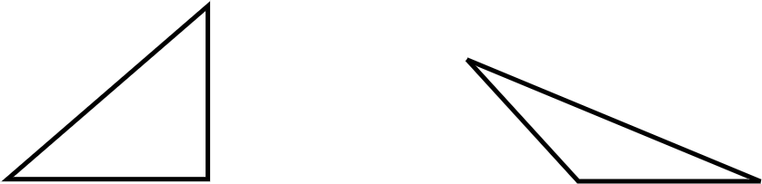
Calculating the area of a triangle
2) Write an expression for the area of each triangle.
a) b)
w
b
3 units
8bc
d
5da

Slide 11
Calculating the area of a triangle
1) Calculate the area of each triangle.
a) b) c)
4 cm
5 cm
2 cm
5 cm
3 cm
4 cm
5 cm
2.5 cm
4 cm
d)
a) Area = ½ × 2.5 × 4
= 5 cm²
3.5 cm
1.2 cm
4.2 cm

Slide 12
Calculating the area of a triangle
1) Calculate the area of each triangle.
a) b) c)
4 cm
5 cm
2 cm
5 cm
3 cm
4 cm
5 cm
2.5 cm
4 cm
d)
b) Area = ½ × 2 × 5
= 5 cm²
3.5 cm
1.2 cm
4.2 cm

Slide 13
Calculating the area of a triangle
1) Calculate the area of each triangle.
a) b) c)
4 cm
5 cm
2 cm
5 cm
3 cm
4 cm
5 cm
2.5 cm
4 cm
d)
c) Area = ½ × 3 × 4
= 6 cm²
3.5 cm
1.2 cm
4.2 cm

Slide 14
Calculating the area of a triangle
1) Calculate the area of each triangle.
a) b) c)
4 cm
5 cm
2 cm
5 cm
3 cm
4 cm
5 cm
2.5 cm
4 cm
d)
d) Area = ½ × 3.5 × 4.2
= 7.35 cm²
3.5 cm
1.2 cm
4.2 cm

Slide 15


Calculating the area of a triangle
2) Write an expression for the area of each triangle.
a) b)
Area = Area =
w
b
3 units
8bc
d
5da

Slide 16
Using the formula for the area of a triangle
Calculating the area of a triangle
Calculating a side length

Slide 17
Calculating a side length
Calculate the height of the triangle.
Area = 33.25 m²
Calculate the base of the triangle.
Area = 24 m²
8 m
height
base
7 m
Area = ½ × base × height
33.25 = ½ × 7 × height
33.25 = 3.5 × height
9.5 m = height
Area = ½ × base × height
24 = ½ × base × 8
24 = 4 × base
6 m = base

Slide 18
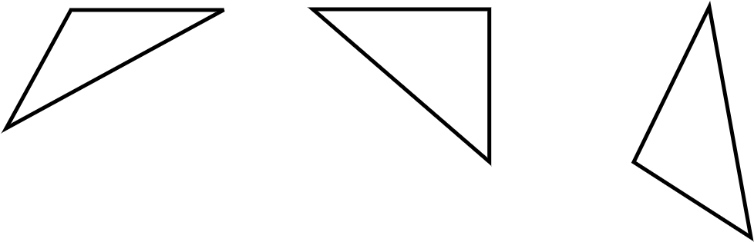
Calculating a side length
1) Calculate the missing side length for each triangle.
a) b) c)
b
2 cm
4.5 cm
6 cm
a
7 cm
c
5 cm

Slide 19
Calculating a side length
2) A triangle has an area of 120 cm². It has a height of 12 cm. What is the length of its base?
3) Another triangle also has an area of 120 cm². What could the lengths of its base and height be? Try to come up with a unique pair of lengths.

Slide 20
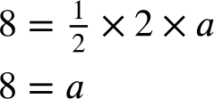
Calculating a side length
1) Calculate the missing side length for each triangle.
a)
2 cm
a
The missing length measures 8 cm

Slide 21
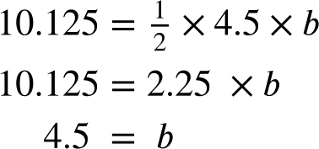
Calculating a side length
1) Calculate the missing side length for each triangle.
b)
b
4.5 cm
The missing length measures 4.5 cm

Slide 22
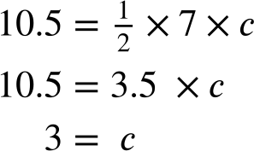
Calculating a side length
1) Calculate the missing side length for each triangle.
c)
6 cm
7 cm
c
The missing length measures 3 cm
5 cm

Slide 23
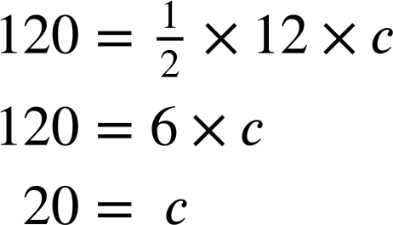
Calculating a side length
2) A triangle has an area of 120 cm². It has a height of 12 cm. What is the length of its base?
The length of the base is 20 cm.

Slide 24
Calculating a side length
3) Another triangle also has an area of 120 cm². What could the lengths of its base and height be? Try to come up with a unique pair of lengths.
Any pair of numbers that have a product of 240 will work.

Slide 25
Using the formula for the area of a triangle
The area of any triangle can be found by multiplying the base by the perpendicular height and dividing by 2.
The formula for finding the area of a triangle can also be used to find a missing side length.

Slide 26

© Oak National Academy 2024.
Produced in partnership with Mathematics in Education and Industry.
Licensed on the Open Government Licence v3.0, except where otherwise stated. See Oak terms and conditions.

